Slide 1











Welcome to my presentation
By : Jeronimo Soto

Slide 2

Who am I?
I’m jeronimo,
but i like people
to call me soto.
I am 17 years old

Slide 3
Where I live and with whom
I am from Colombia, and i live in itagui with
my mom, my dad, my two sisters and my brother.
I have another sister but she lives in Spain.

Slide 4

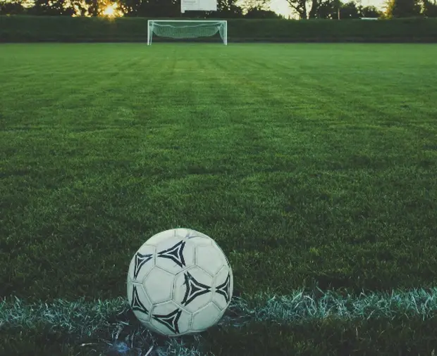
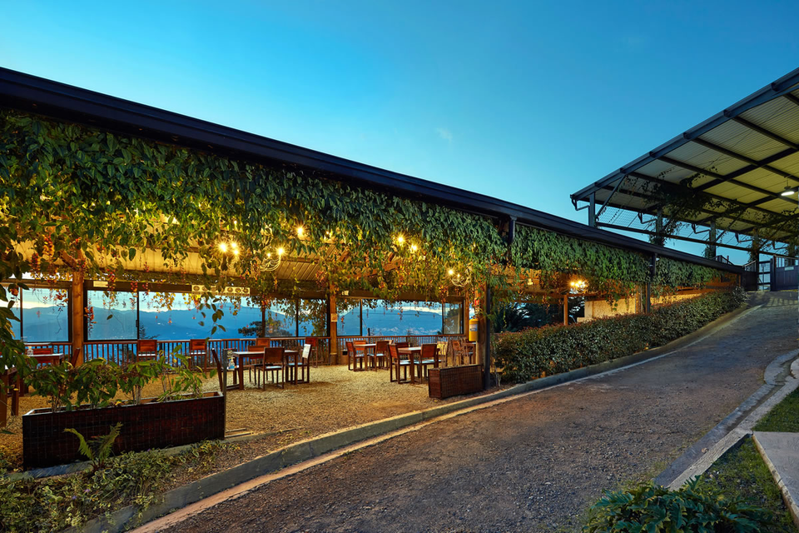
What is my routine?
I currently study in Riwi during the week. On weekends, I work at a restaurant (LA BONANZA).
In my free time, I play soccer from time to time.
As a hobby, I like to play soccer and always enjoy learning new things.

Slide 5
Thanks for watching

